Slide 1
Calculations
Dr. Stephen Dotson

Slide 2
Calculations
Molar mass – amount of grams/mole (on periodic table)
Mole – The Chemist dozen – 6.02 x 10²³
Molarity (M) = mol/L
Percent Composition – percent of each element in a compound

Slide 3
Molar Mass
The mass of carbon-12 (6 proton and 6 neutrons) is 12 grams/mol
  This is what we refer to as it’s molar mass
Each atom has its own molar mass (mass number)
  The mass number of each element is just the grams/1mol of that atom
This works with compounds (just add up the elements)

Slide 4
Molar Mass - Calculation
What is the molar mass of NaCl?
  Na – 22.9898 g/mol
  Cl – 35.453 g/mol
  Just add
  So NaCl – 58.4428 g/mol

Slide 5
Molar Mass - Calculation
What is the molar mass of H₂O?
  H – 1.008 g/mol (x2)
  O – 15.999 g/mol
  Just add
  So H₂O – 18.015 g/mol

Slide 6
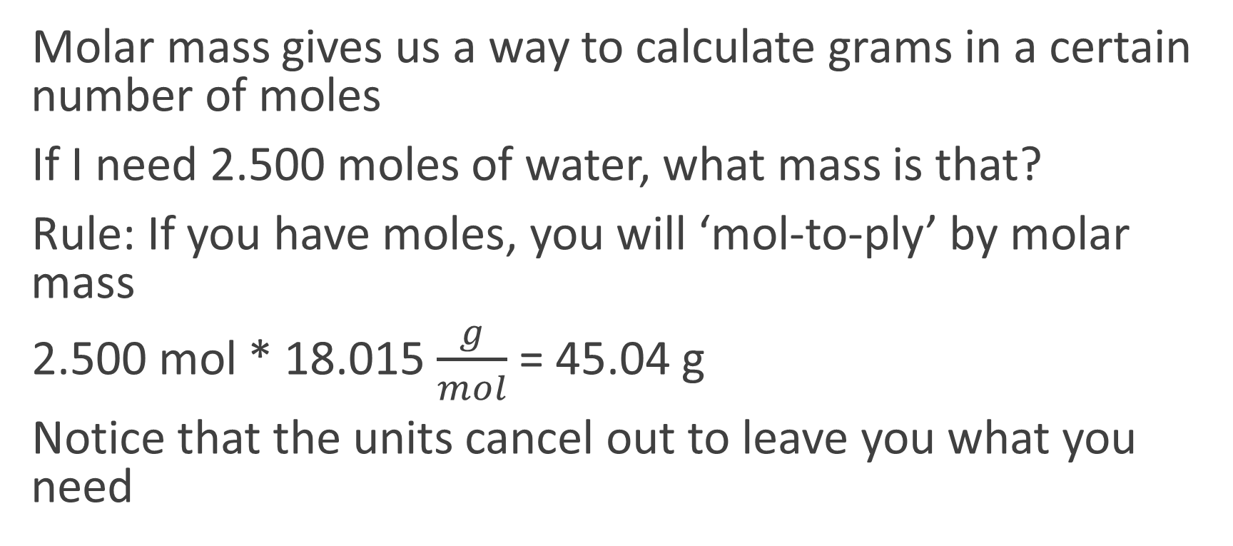
Molar Mass – moles to grams
Molar mass gives us a way to calculate grams in a certain number of moles
If I need 2.500 moles of water, what mass is that?
Rule: If you have moles, you will ‘mol-to-ply’ by molar mass
2.500 mol * 18.015 $\frac{g}{mol}$ = 45.04 g
Notice that the units cancel out to leave you what you need

Slide 7
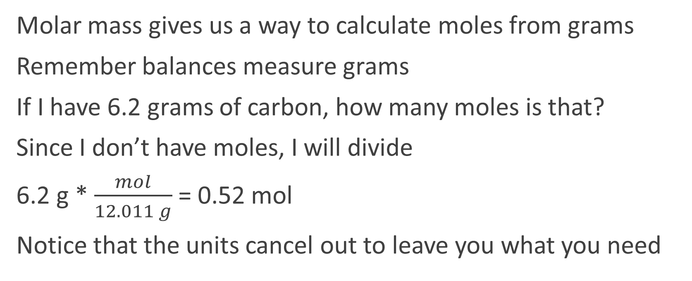
Molar Mass – grams to moles
Molar mass gives us a way to calculate moles from grams
Remember balances measure grams
If I have 6.2 grams of carbon, how many moles is that?
Since I don’t have moles, I will divide
6.2 g * $\frac{mol}{12.011 g}$ = 0.52 mol
Notice that the units cancel out to leave you what you need

Slide 8
Mole (mol)
The mass of carbon-12 (6 proton and 6 neutrons) is 12 grams/mol
What is a mol?
  It is the chemists way of counting large numbers of particles/atoms
  1 mol of anything is equal to 6.02 x 10²³ (called Avogadro’s number)
  1 mol of candies would be 6.02 x 10²³ candies
So back to carbon-12
  1 mol of carbon atoms (6.02 x 10²³ ) has a mass of 12 grams: 12g/mol
  That’s way easier to write than: 12 grams/ 6.02 x 10²³ atoms

Slide 9
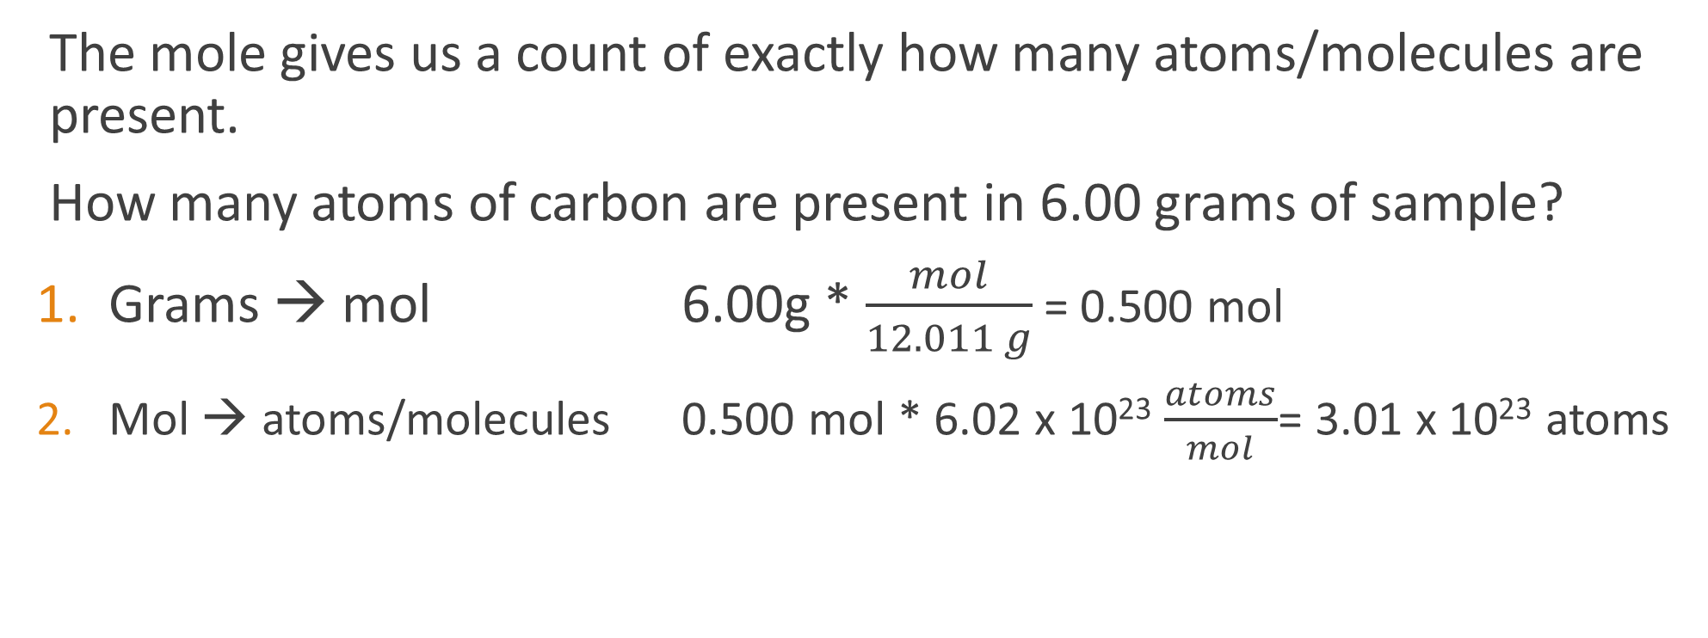
Mole (mol)
The mole gives us a count of exactly how many atoms/molecules are present.
How many atoms of carbon are present in 6.00 grams of sample?
Grams → mol 6.00g * $\frac{mol}{12.011 g}$ = 0.500 mol
Mol → atoms/molecules 0.500 mol * 6.02 x 10²³ $\frac{atoms}{mol}$= 3.01 x 10²³ atoms

Slide 10
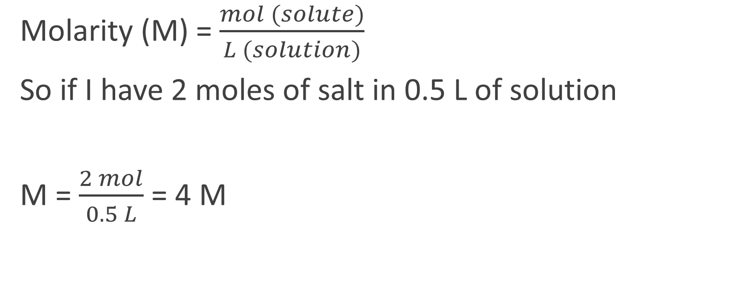
Molarity (M)
Molarity (M) = $\frac{mol (solute)}{L (solution)}$
So if I have 2 moles of salt in 0.5 L of solution
M = $\frac{2 mol}{0.5 L}$ = 4 M

Slide 11
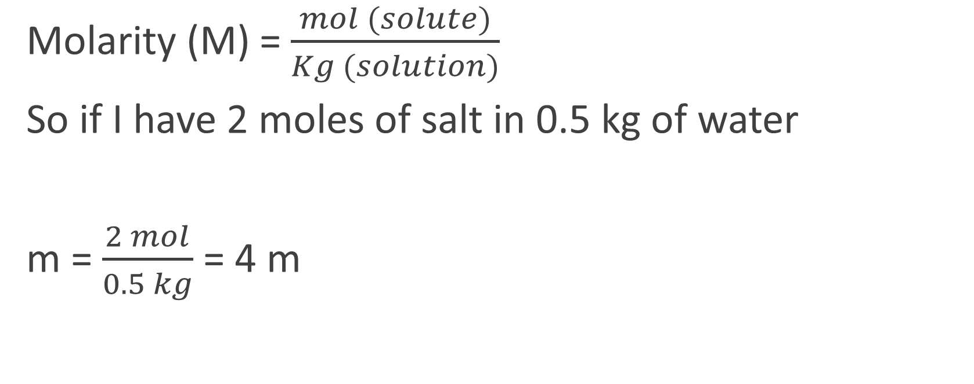
Molality (m)
Molarity (M) = $\frac{mol (solute)}{Kg (solution)}$
So if I have 2 moles of salt in 0.5 kg of water
m = $\frac{2 mol}{0.5 kg}$ = 4 m

Slide 12
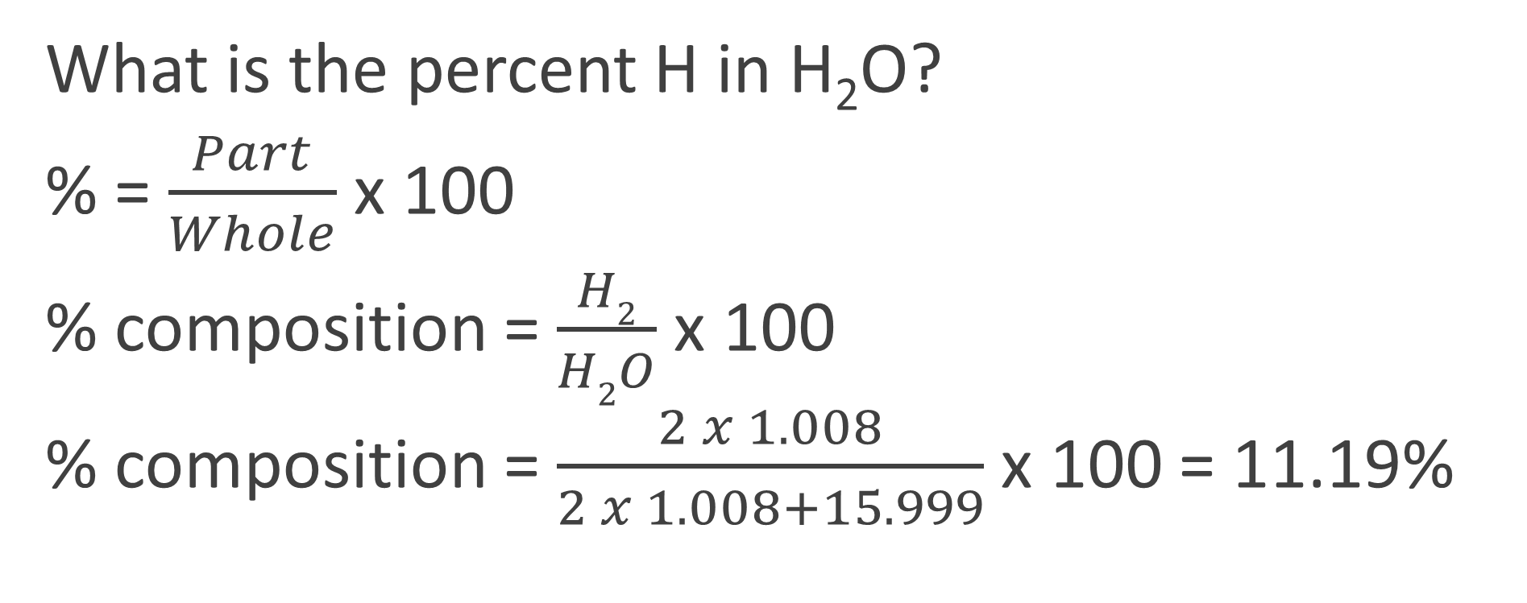
Percent Composition
What is the percent H in H₂O?
% = $\frac{Part}{Whole}$ x 100
% composition = $\frac{H2}{H2O}$ x 100
% composition = $\frac{2 x 1.008}{2 x 1.008+15.999}$ x 100 = 11.19%

Slide 13
Percent Composition to Empirical Formula
Empirical Formula Steps:
Divide each % composition by the molar mass of the element to get molar ratio (36.033% carbon / 12.011 = 3)
Divide all molar ratios by the smallest molar ratio (3-C 6-H means divide by 3 -→ 1-C 2-H)
Write formula with whole numbers (CH₂). Remember you don’t write 1.

Slide 14
Empirical Formula to Molecular Formula
Molecular Formula Steps:
Take the molar mass (will be given) for the compound and divide by the molar mass of the empirical formula (you calculate) – should get a whole number (or very close and round)
Multiply the empirical formula by the whole number from step 1 (example Empirical – CH₂, whole number 2, so molecular formula = 2 x CH₂ = C₂H₄)

