Slide 1
Understanding the History of Atoms
Dr. Dotson

Slide 2
The First ‘Atom’
Ancient Greek philosopher Democritus (around 400 BCE) theorized that there was a particle that couldn’t be destroyed
However it wasn’t until the 1800’s that Dalton was able to shoe evidence that it existed
They theorized that the atom was:
  Atoms of different elements were different (RIGHT!)
  Atoms were indivisible (WRONG!)
ATOM
Dalton/Democritus Model of the Atom

Slide 3
Electrons
Thompson discovered the electrons (early 1900’s) and had to revise the model
He theorized:
  The atom was a positive charge (WRONG!)
  The electrons in the atom were negative making the charge neutral (RIGHT!)
-
-
-
-
Thompson
Model of the Atom

Slide 4
Nucleus
Rutherford (1911) shot atoms with a particle and discovered a densely packed core of positive which we now call the nucleus
He theorized:
  The nucleus has all the positive charge (RIGHT!)
  The electrons just orbit around (Kind of right)
-
-
-
Rutherford
Model of the Atom

Slide 5
Quantized electrons
Bohr (1913) revised Rutherford’s theory to account for emission spectrum of atoms.
He theorized:
  Electrons can only be at certain locations, quantized (RIGHT!)
  However his model didn’t work for larger atoms (so close)
-
-
-
Bohr
Model of the Atom

Slide 6
Quantum Mechanical
Schrodinger theorized that electrons didn’t move in orbit but as waves
This is our current model of the atom
Bohr
Model of the Atom

Slide 7
Atom Basics
All elements are made of atoms.
An atom of one element is different than any other
The number of protons (+) determines the element
Neutrons, no charge (0), are like glue that hold the protons together in a nucleus
The electrons (-), the cloud behind the nucleus, equal the number of protons when there is no charge on the atom

Slide 8
Bohr Diagrams
Bohr models do a great job for the first 20 or so elements so we use those to help learn the basics
How many protons, neutrons, and electrons would a helium atom have if there is a total mass of 4?
Protons – defined by element (He = 2)
Neutrons = total mass – protons (4-2 = 2)
Electrons = number protons unless charged (2=2)

Slide 9
Bohr Diagrams
Draw the nucleus
Tell the number of protons and neutrons
Draw rings (only as many as you need)
  First ring – 2 electrons
  Second ring – 8 electrons
  Third ring – 18 electrons
Carbon – 12 (total mass)
6 protons
6 neutrons
Note there is still room for 2 more electrons in the second ring but I used all I had

Slide 10
Drawing atoms/Lewis Dot
H with 1 proton and no neutrons (so 1 electron)
That is hard to see so we use Lewis Dot method
Give the symbol and put the number of electrons around it
You can have up to 8 dots
H

Slide 11
Lewis Dot Practice
In Lewis Dot we only draw dots for the electrons in the outer ring (valence electrons)
Try Oxygen

Slide 12
Lewis Dot Practice
In Lewis Dot we only draw dots for the electrons in the outer ring (valence electrons)
Try Oxygen
O

Slide 13
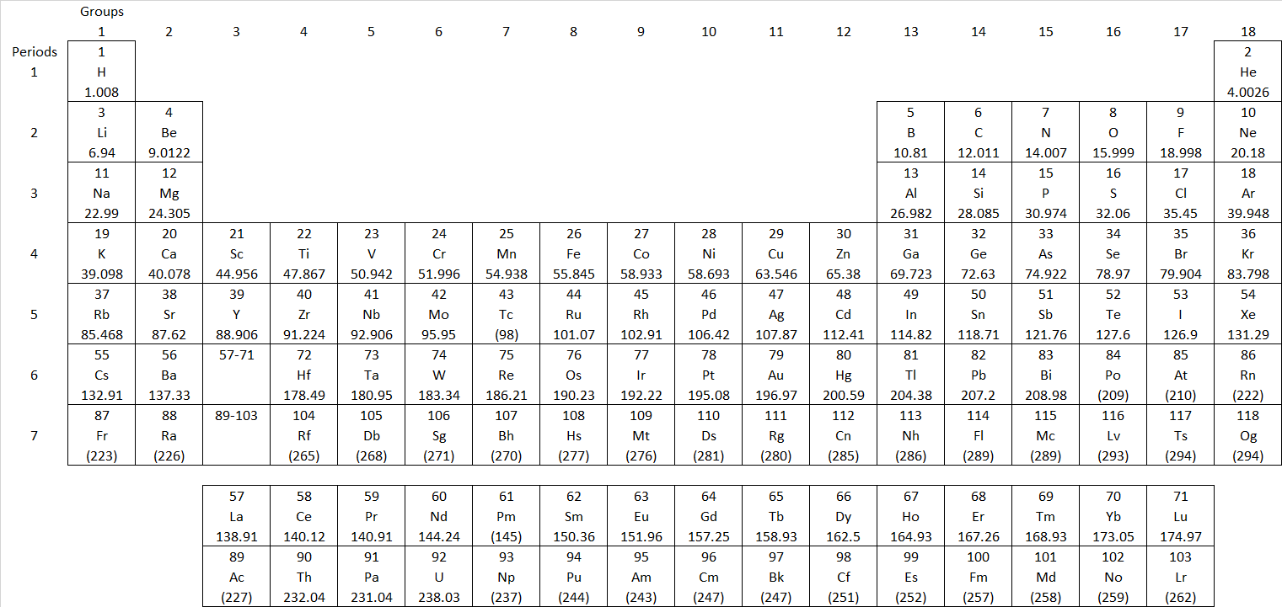
The Periodic Table
Mendeleev (1871) was the first to start organizing elements by properties, this was the first Periodic table

Slide 14
The Periodic Table – Groups and Periods
Across the top is the group number
  Elements in the same group behave similarly
Periods are numbered on the left side
  These show an increasing energy level (think rings of Bohr model)

Slide 15
The Periodic Table – Trends
EN, IE, EA
Bottom Left – Largest atom
Top Right – Largest
  Electronegativity
  Ionization energy
  Electron affinity
Larger

Slide 16
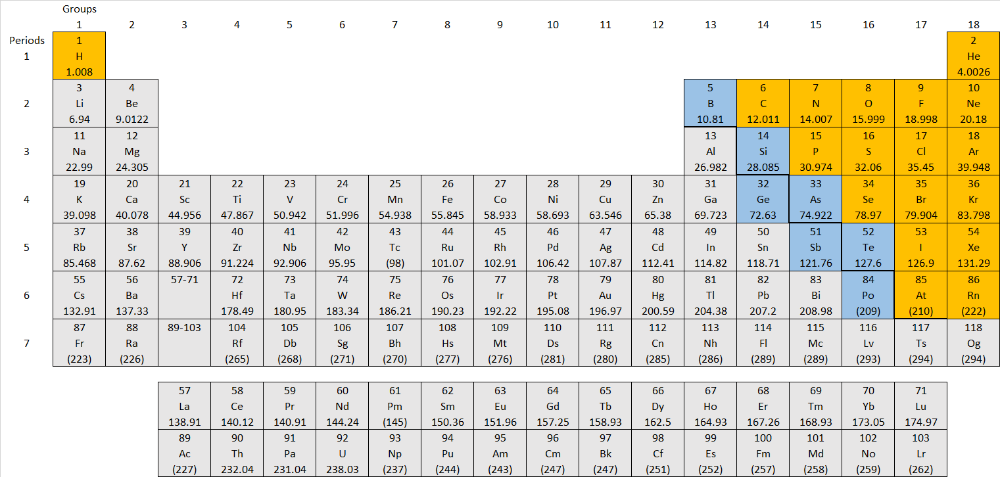
The Periodic Table – Groups and Periods
Most of the periodic table is metals – gray (bottom left)
Most of the nonmetals are in the top right – orange (H is also nonmetal)
A metalloid can behave like either (blue)

Slide 17
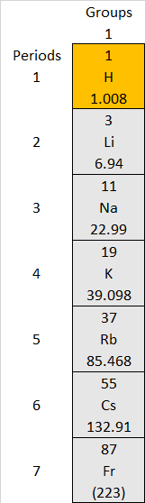
Families
Alkali Metals – Blow up when thrown in water
Found in Group 1
Does not include H
Have 1 valence e⁻

Slide 18

Families
Alkaline Earth Metals – also very reactive
Found in Group 2
Have 2 valence e⁻

Slide 19
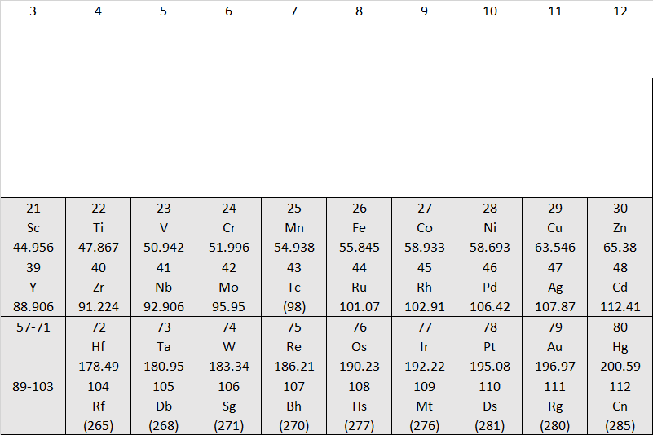
Families
Transition Metals – good conductors
Found in Group 3-10
Have varying valence e⁻

Slide 20

Families
Halogens – most reactive nonmetals
Found in Group 17
Have 7 valence e⁻

Slide 21

Families
Noble gases – (SNOBS) they don’t react much at all
Found in Group 18
Have 8 valence e⁻ (completed shell)
Everyone wants to be like these

Slide 22
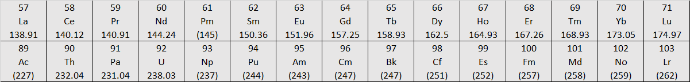
Families
Rare earth elements
Found at bottom of periodic table
Lathanoides
Actanoides

Slide 23
The Periodic Table – Positive Elements
Groups like to become different charges
Group 1: +1
Group 2: +2
Skip 3-12
Group 13: +3

Slide 24
The Periodic Table – Negative Elements
Groups like to become different charges
Group 17: -1
Group 16: -2
Group 15: -3

