Slide 1
Naming Compounds
Dr. Dotson

Slide 2
Three (3) Types of Bonds
It is important to know if you have metals, nonmetals, or metalloids
A metal to a nonmetal – ionic
  Charges are transferred from one atom to another
  Bond is formed from difference in charge
A nonmetal to a nonmetal – covalent
  Electrons are shared between atoms
A metal to a metal – alloy (metals are good conductors)
  Electrons go wherever they want (we won’t be naming these right now)

Slide 3
1 Ionic Bonds
If you have a sodium atom and a chlorine atom, how do they become salt
Remember valence electrons, the sodium has 1 and chlorine has 7. Both want to look like noble gases.
The sodium metal will give it’s 1 electron to chlorine becoming Na⁺
The chlorine nonmetal gets the extra electron making it Cl⁻
As opposite charges attract, NaCl is neutral and held together by the charge difference (CHARGES MUST BE BALANCED)

Slide 4
1 Naming simple Ionic Bonds
NaCl – metal to nonmetal, so ionic. How do you name?
The first element (metal) is straight from the periodic table sodium
The second element (nonmetal) chlorine replaces the ending with –ide, chloride
Together – sodium chloride
Now you try – CaBr₂ (the number of atoms doesn’t affect the name)

Slide 5
1 Naming simple Ionic Bonds
CaBr₂ – metal to nonmetal, so ionic. How do you name?
The first element (metal) is straight from the periodic table Calcium
The second element (nonmetal) bromine replaces the ending with –ide, bromide
Together – calcium bromide
Now you try going backwards – find the formula for
magnesium chloride

Slide 6
1 Naming simple Ionic Bonds
Magnesium chloride – metal to nonmetal, so ionic. What is the formula?
The first element (metal) is straight from the periodic table Mg
The second element (nonmetal) chloride replaced the ending with –ide, chlorine
Together – MgCl (but what about charges) Mg likes +2 while Cl likes -1
BALANCE THEM – I need 2 Cl to balance the charge on Mg so MgCl₂
Now you try going backwards – find the formula for
Potassium oxide

Slide 7
1 Naming simple Ionic Bonds
Potassium oxide – metal to nonmetal, so ionic. What is the formula?
The first element (metal) is straight from the periodic table K
The second element (nonmetal) oxide replaced the ending with –ide, oxygen
Together – KO (but what about charges) K likes +1 while O likes -2
BALANCE THEM – I need 2 K to balance the charge on O so K₂O

Slide 8
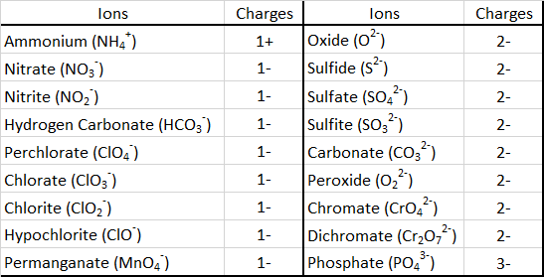
1b Naming Ionic Bonds: polyatomic
Polyatomics (multiple atoms) are groups that stay together and behave like an element
Many of these will be given to you
Subscript is how many atoms of each
Superscript (above) is charge
If you need more than 1 of them put
them in parenthesis (example: Calcium (+2) Nitrite (-1): Ca(NO₂)₂
Try giving formula for Potassium Nitrate

Slide 9
1b Naming Ionic Bonds: polyatomic
Try giving formula for Potassium Nitrate
Potassium – K
From table Nitrate – NO₃
KNO₃ (and already balanced by charge)
Try a harder one aluminum sulfate

Slide 10
1b Naming Ionic Bonds: polyatomic
Try a harder one aluminum sulfate
Aluminum – Al³⁺ (valence electrons)
Sulfate – SO₄²⁻ (from table)
Balance charge 3+ and 2- (get common number 6)
2Al = +6 3SO₄ = -6
Combine Al₂(SO₄)₃

Slide 11
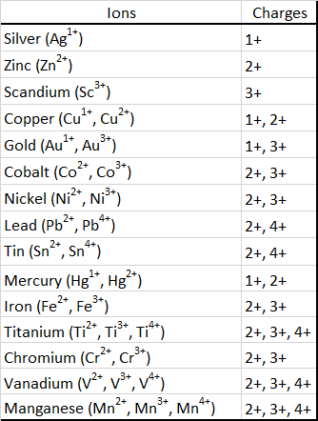
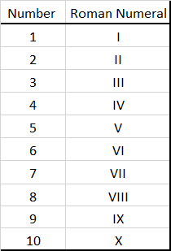
1C Naming Ionic Bonds transition metals
Transition metals can have multiple charges and must give detail on the charge in the name by a roman numeral
Give formula for Lead (II) Chloride
  Pb (+2-from roman numeral) Cl (-1 - valence) – PbCl₂
If you have FeCl3 you can name it
  Iron (?) chloride (what is charge on Fe? – 3)
  Iron (III) chloride

Slide 12
Naming Ionic Bonds
Try it
1: Sodium sulfate
2: Potassium oxide
3: Silver chloride
4: Tin (II) carbonate
5: Fe(NO₂)₂
6: NaHCO₃
7: VPO₄
8: CaCr₂O₇

Slide 13
Naming Ionic Bonds
Try it
1: Sodium sulfate – Na₂SO₄
2: Potassium oxide – K₂O
3: Silver chloride – AgCl (no roman numeral required)
4: Tin (II) carbonate – SnCO₃
5: Fe(NO₂)₂ – Iron (II) nitrite
6: NaHCO₃ – Sodium hydrogen carbonate
7: VPO₄ – Vanadium (III) phosphate
8: CaCr₂O₇ – Calcium dichromate

Slide 14
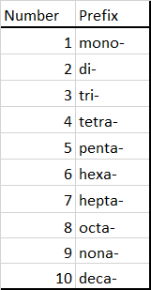
2 Naming Covalent bonds
(2 nonmetals - Much easier)
There are no charges to balance so the name must tell you how many atoms there are
The first element is named from periodic table with the prefix for how many (no prefix if it is mono-)
The second element is named from the periodic table with the prefix but once again the –ide ending is added
For the formula, CCl₄, the name is carbon tetrachloride
You try C₂Br₆

Slide 15
2 Naming Covalent bonds
(2 nonmetals - Much easier)
You try C₂Br₆ – dicarbon hexabromide
Try these:
1: N2O3
2: CH4
3: Trinitrogen pentoxide
4: carbon disulfide

Slide 16
2 Naming Covalent bonds
(2 nonmetals - Much easier)
You try C₂Br₆ – dicarbon hexabromide
Try these:
1: N₂O₃ – dinitrogen trioxide
2: CH₄ – carbon tetrahydride
3: trinitrogen pentoxide – N₃O₅
4: carbon disulfide – CS₂

Slide 17
Binary Acids
As the name implies, there are 2 things in this acid
H – All acids produce H⁺ when put in water (that’s what burns) so that’s what the formula starts with
Example: HCl – Hydrochloric Acid
  Put Hydro
  Put _____ic Acid
  Fill in blank with other element

Slide 18
Naming Binary Acids
Try these:
  HBr
  HI
  HF

Slide 19
Naming Binary Acids
Try these:
  HBr – Hydrobromic Acid
  HI – Hydroiodic Acid
  HF – Hydrofluoric Acid

Slide 20
Acids from Polyatomic
A lot of acids come with polyatomic ions. Example:
SO4²⁻ Sulfate
H2SO4 Sulfuric Acid
Take the name of the polyatomic and add
ate → ic acid
ite →ous acid

Slide 21
Acids from Polyatomic
The variations of chlorine and oxygen have the possible combinations:
Hypochlorite ClO⁻ → Hypochlorous acid HClO
Chlorite ClO₂⁻ → Chlorous acid HClO₂
Chlorate ClO₃⁻ → Chloric acid HClO₃
Perchlorate ClO₃⁻ → Perchloric acid HClO₃
Notice how only the ending changes ate - ic ite - ous

Slide 22
Try These
HCl -
H2SO4 -
H2CO3 -
HNO3 -
HNO2 -

Slide 23
Try These
HCl – Hydrochloric Acid
H2SO4 – Sulfuric Acid
H2CO3 – Carbonic Acid
HNO3 – Nitric Acid
HNO2 – Nitrous Acid

