Slide 1
Stoichiometry
Dr. Stephen Dotson

Slide 2
Stoichiometry
Looking at the quantities of atoms/molecules involved in reactions
Involves:
  Balanced equations
  Reaction types
  Calculations (multistep)

Slide 3
Start Simply Example 1
Balance the equation
__H₂ + __O₂ → __H₂O

Slide 4
Start Simply Example 1
Balance the equation
_2_H₂ + _1_O₂ → _2_H₂O
Now, what kind of reaction is it?

Slide 5
Start Simply Example 1
Balance the equation
_2_H₂ + _1_O₂ → _2_H₂O
Now, what kind of reaction is it?
Synthesis

Slide 6
Start Simply Example 1
How much H₂ do I need if I want to make 6 moles of H₂O (assume plenty of O₂)
_2_H₂ + _1_O₂ → _2_H₂O

Slide 7
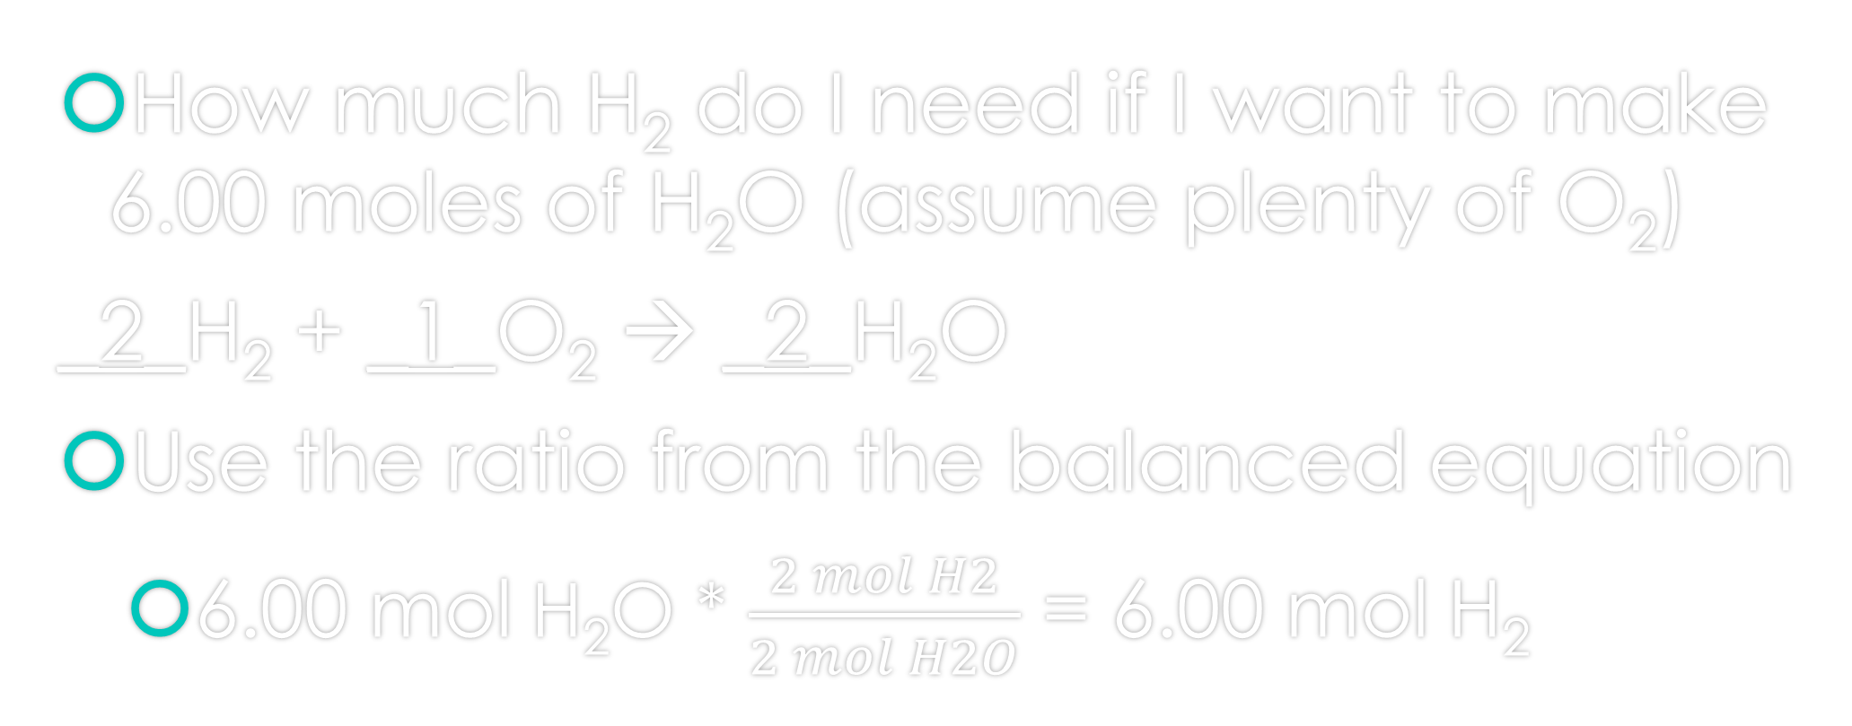
Start Simply Example 1a (1 step problem)
How much H₂ do I need if I want to make 6.00 moles of H₂O (assume plenty of O₂)
_2_H₂ + _1_O₂ → _2_H₂O
Use the ratio from the balanced equation
  6.00 mol H₂O * $\frac{2 mol H2}{2 mol H2O}$ = 6.00 mol H₂

Slide 8
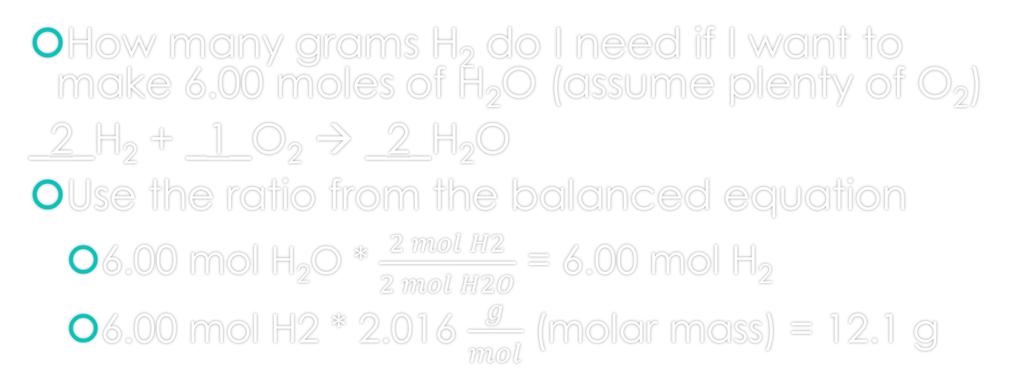
Example 1b (2 step problem)
How many grams H₂ do I need if I want to make 6.00 moles of H₂O (assume plenty of O₂)
_2_H₂ + _1_O₂ → _2_H₂O
Use the ratio from the balanced equation
  6.00 mol H₂O * $\frac{2 mol H2}{2 mol H2O}$ = 6.00 mol H₂
  6.00 mol H2 * 2.016 $\frac{g}{mol}$ (molar mass) = 12.1 g

Slide 9
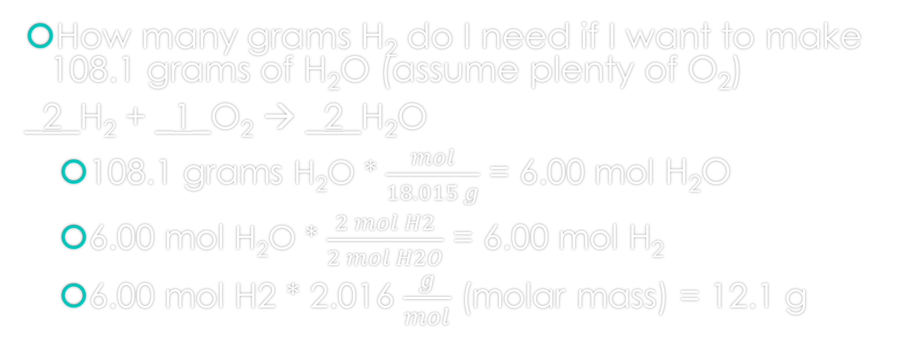
Example 1c (3 step problem)
How many grams H₂ do I need if I want to make 108.1 grams of H₂O (assume plenty of O₂)
_2_H₂ + _1_O₂ → _2_H₂O
  108.1 grams H₂O * $\frac{mol}{18.015 g}$ = 6.00 mol H₂O
  6.00 mol H₂O * $\frac{2 mol H2}{2 mol H2O}$ = 6.00 mol H₂
  6.00 mol H2 * 2.016 $\frac{g}{mol}$ (molar mass) = 12.1 g

Slide 10
Summary of Calculations
Mol A to mol B – 1 step (use the ratio in balanced equation)
Gram A to mol B – 2 step (1: gram to mol by molar mass then 2: mol to mol step)
Mol A to gram B – 2 step (1: mol to mol step then 2: mol to gram by molar mass)
Gram A to gram B – 3 step (1: gram to mol by molar mass then 2: mol to mol step then 3: mol to gram by molar mass)
Particles/atoms to mol – 1 step (Divide by Avogadro’s number)
Mol to particles/atoms – 1 step (Multiply by Avogadro’s number)

Slide 11
Example 2 – even harder
How many grams of ammonia can be made from 6 grams of nitrogen gas and 4 grams of hydrogen gas?

Slide 12
Example 2 – Step 1 Write the equation
How many grams of ammonia can be made from 6 grams of nitrogen gas and 4 grams of hydrogen gas?
Write equation and balance:
N₂ + 3H₂ → 2NH₃

Slide 13
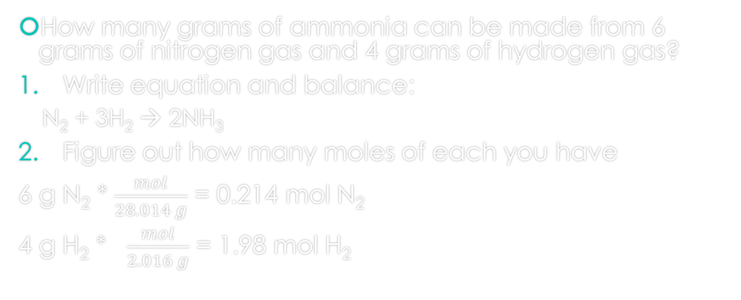
Example 2 – Step 2 find moles
How many grams of ammonia can be made from 6 grams of nitrogen gas and 4 grams of hydrogen gas?
Write equation and balance:
  N₂ + 3H₂ → 2NH₃
Figure out how many moles of each you have
6 g N₂ * $\frac{mol}{28.014 g}$ = 0.214 mol N₂
4 g H₂ * $\frac{mol}{2.016 g}$ = 1.98 mol H₂

Slide 14
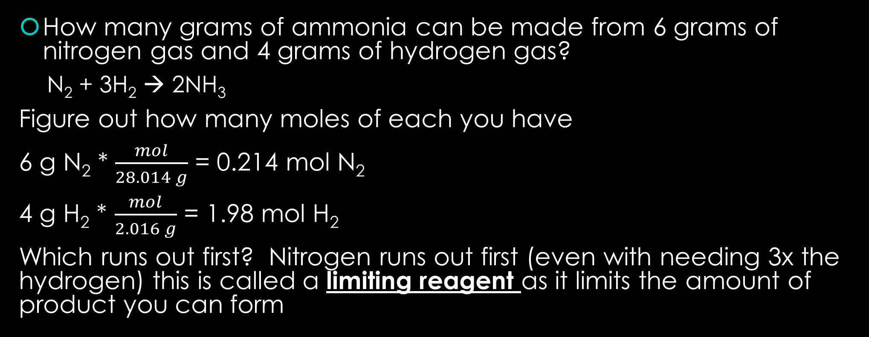
Example 2 – Step 3 find limiting reagent
How many grams of ammonia can be made from 6 grams of nitrogen gas and 4 grams of hydrogen gas?
  N₂ + 3H₂ → 2NH₃
Figure out how many moles of each you have
6 g N₂ * $\frac{mol}{28.014 g}$ = 0.214 mol N₂
4 g H₂ * $\frac{mol}{2.016 g}$ = 1.98 mol H₂
Which runs out first? Nitrogen runs out first (even with needing 3x the hydrogen) this is called a limiting reagent as it limits the amount of product you can form

Slide 15
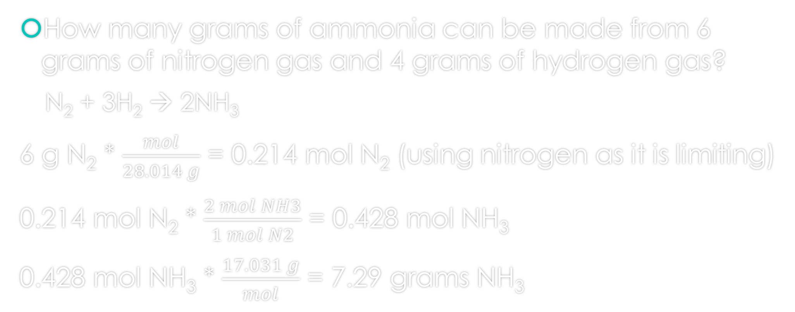
Example 2 – Step 4 finish the calculation
How many grams of ammonia can be made from 6 grams of nitrogen gas and 4 grams of hydrogen gas?
  N₂ + 3H₂ → 2NH₃
6 g N₂ * $\frac{mol}{28.014 g}$ = 0.214 mol N₂ (using nitrogen as it is limiting)
0.214 mol N₂ * $\frac{2 mol NH3}{1 mol N2}$ = 0.428 mol NH₃
0.428 mol NH₃ * $\frac{17.031 g}{mol}$ = 7.29 grams NH₃

Slide 16
Stoichiometry heart
Balanced equation:
A + 3B → 2C + D
X2
mol A
mol C
The heart of stoichiometry is using the molar ratio from a balanced equation: you must be in moles!
Everything else is getting to moles or getting to whatever unit you want

Slide 17
Stoichiometry - grams
Balanced equation:
A + 3B → 2C + D
g A
g C
/mm
X mm
X2
mol A
mol C
Grams to mole – divide by molar mass
mol to gram – multiply by molar mass
If you have moles, you will mol-to-ply

Slide 18
Stoichiometry – molecules or atoms
Balanced equation:
A + 3B → 2C + D
g A
g C
X2
mol A
mol C
molecules C
molecules A
X Avogadro
/Avogadro
Molecules to mole – divide by Avogadro’s number
mol to gram – multiply by Avogadro’s number (6.02 x 10²³)
If you have moles, you will mol-to-ply

Slide 19

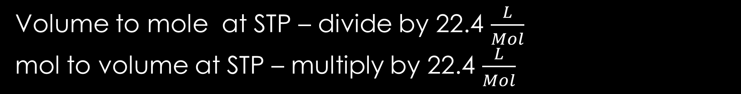

Stoichiometry – molar volume at STP
Balanced equation:
A + 3B → 2C + D
g A
g C
X2
mol A
mol C
molecules C
molecules A
/22.4 $\frac{L}{mol}$
X 22.4 $\frac{L}{mol}$
L of A
L of C
Volume to mole at STP – divide by 22.4 $\frac{L}{Mol}$
mol to volume at STP – multiply by 22.4 $\frac{L}{Mol}$

Slide 20
Stoichiometry – molar volume at STP
Balanced equation:
A + 3B → 2C + D
g A
g C
X2
mol A
mol C
molecules C
molecules A
L of A
L of C
While it looks complicated, remember the units will tell you what you need to do. The second step is always using the balanced equation. Practice helps make it easier

Slide 21
Stoichiometry – Limiting
Balanced equation:
A + 3B → 2C + D
X3
mol A
mol B
If you have 1 mol of A and 3 mol of B they are stoichiometrically balanced (run out at the same time)

Slide 22
Stoichiometry – Limiting
Balanced equation:
A + 3B → 2C + D
X3
mol A
mol B
Which one is limiting if you have 3 mol of A and 1 mol of B?
3 mol A x 3 = 6 mol B needed to react but I only have 1 mol
This makes B the Limiting Reagent as it limits how much product will form

Slide 23
Stoichiometry – Percent Yield
Balanced equation:
A + 3B → 2C + D
X2
mol A
mol C
If we have 1.0 mol of A we would expect 2.0 mol of C this is called the theoretical yield
However no reaction goes to 100% so we can calculate the percent yield

Slide 24
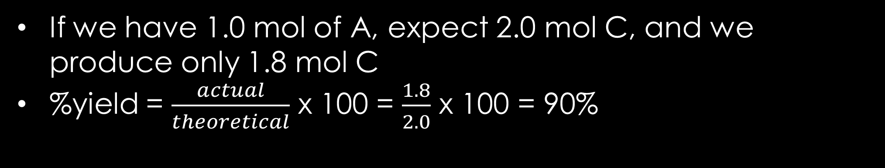
Stoichiometry – Percent Yield
Balanced equation:
A + 3B → 2C + D
X2
mol A
mol C
If we have 1.0 mol of A, expect 2.0 mol C, and we produce only 1.8 mol C
%yield = $\frac{actual}{theoretical}$ x 100 = $\frac{1.8}{2.0}$ x 100 = 90%

