Slide 1
Orbitals and Electron Configuration
Dr. Dotson

Slide 2
Orbitals
The electrons don’t go around the nucleus in perfect rings but in orbitals with different shapes
4 types of orbitals are known in the quantum mechanical model
  s – Group 1 and 2 (H and He)
  p – Group 13-18 (excluding He)
  d – Group 3-12 (transition metals)
  f – Lanthanide and Actinide Series (bottom of the periodic table)

Slide 3
Electron Configuration
Electron configuration is the electron’s ‘address’
No 2 electrons can have the same address (Pauli exclusion principle)
Example: H – 1s¹
The first number is the energy level, the letter is the orbital, and the superscript is how many electrons are in that orbital.
Example: O – 1s² 2s² 2p⁴
With oxygen, you go through the first four electron in s orbitals before starting to fill the p orbital
Examples are given for each orbital but I’ll show you how to do this after we describe the orbitals

Slide 4
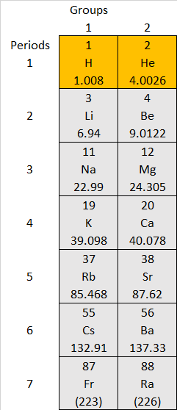
s - Orbital
s
Looks like: a sphere (electron cloud)
Number of shapes: 1
Each energy level is just a larger sphere
How many electrons allowed: 2
Energy Level Starts at: 1
Examples:
  H – 1s¹ electron
  He – 1s²
  Li – 1s² 2s¹

Slide 5
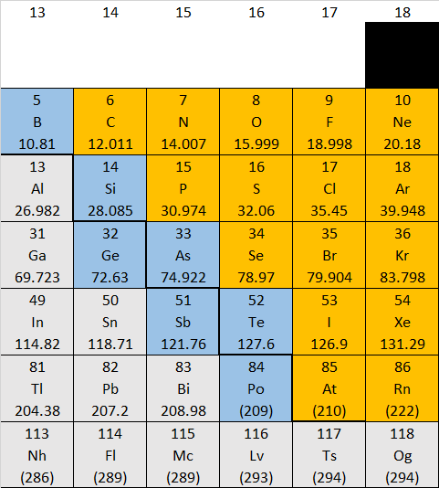
p - Orbital
z
z
z
Looks like: a dumbbell(electron cloud)
Number of shapes: 3 (add 2 to previous)
Each energy level is just larger
How many electrons allowed: 6
Energy Level Starts at: 2
Examples:
  B – 1s² 2s² 2p¹ electrons
  O – 1s² 2s² 2p⁴
  Al – 1s² 2s² 2p⁶3s² 3p¹
y
x
y
x
y
x

Slide 6
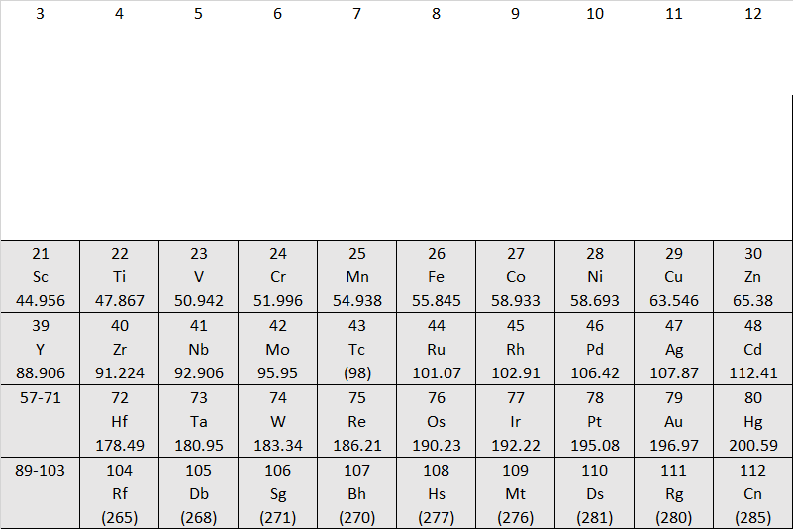
d - Orbital
z
z
Looks like: 2 dumbbell in x and a dumbbell with doughnut (electron cloud)
Number of shapes: 5 (add 2 to previous)
Each energy level is just larger
How many electrons allowed: 10
Energy Level Starts at: 3
Examples:
  Sc – 1s² 2s² 2p⁶3s² 3p⁶4s²3d¹ electrons
  Zn – 1s² 2s² 2p⁶3s² 3p⁶4s²3d¹⁰
  Cd – 1s² 2s² 2p⁶3s² 3p⁶4s²3d⁶4p⁶5s²4d¹⁰
y
x
y
x
4 different orientations
1 shape
+

Slide 7
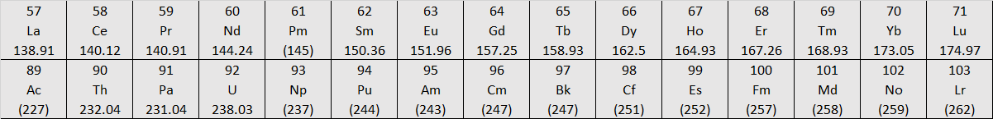
f - Orbital
z
Looks like: 8 pronged monstrosity (not going to draw)and 2 doughnuts on dumbbell
Number of shapes: 7 (add 2 to previous)
Each energy level is just larger
How many electrons allowed: 14
Energy Level Starts at: 4
Examples:
  Pr – 1s²2s²2p⁶3s²3p⁶4s²3d⁶4p⁶5s²4d⁹5p⁶6s²4f³
  Yb – 1s²2s²2p⁶3s²3p⁶4s²3d⁶4p⁶5s²4d⁹5p⁶6s²4f¹⁴
y
x
6 shapes with multiple prongs
1 shape
+

Slide 8
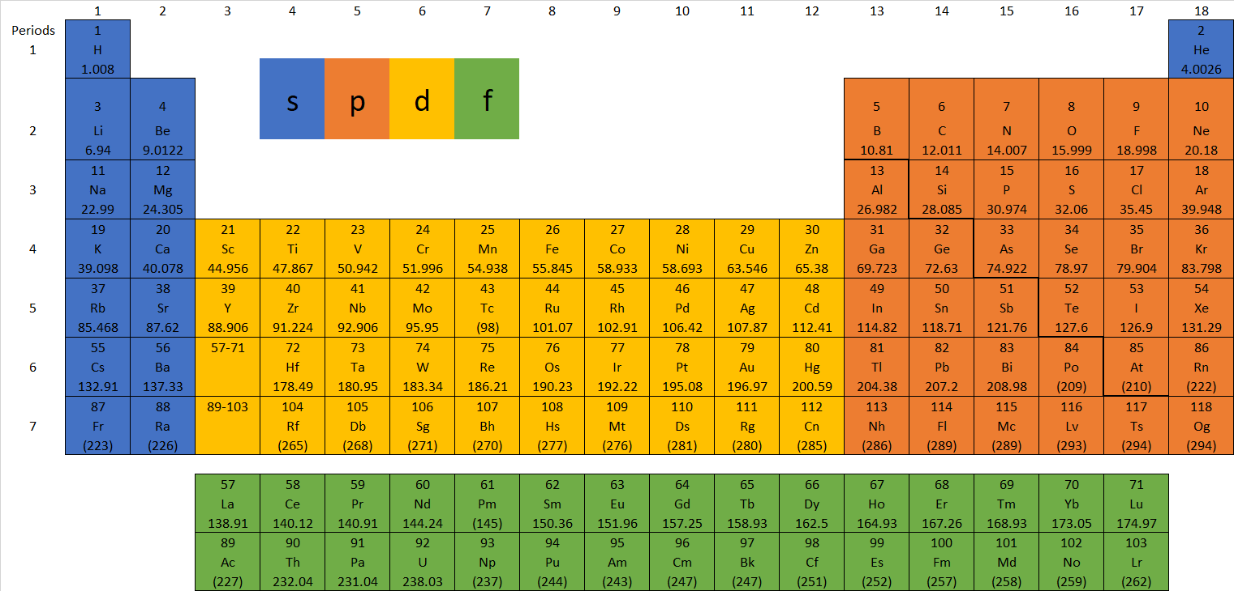
Electron Configuration
H – 1s¹ only 1 electron, Period (left number)tells you energy level and look at the table to see orbital and fill each orbital before moving on
He – 1s² (s orbital now full)
Li – 1s² 2s¹
Be – 1s² 2s²
Be – 1s²2s²2p¹
(move to p orbital)

Slide 9
Electron Configuration
C – 1s²2s²2p²
N – 1s²2s²2p³
O – 1s²2s²2p⁴ F – 1s²2s²2p⁵ Ne – 1s²2s²2p⁶
Noble gases are a completed shell. Every atom wants a completed shell
Na – 1s²2s²2p⁶3s¹ Mg – 1s²2s²2p⁶3s²
Al – 1s²2s²2p⁶3s²3p¹ Si – 1s²2s²2p⁶3s²3p² P – 1s²2s²2p⁶3s²3p¹
S – 1s²2s²2p⁶3s²3p⁴ Cl – 1s²2s²2p⁶3s²3p⁵ Ar – 1s²2s²2p⁶3s²3p⁶

Slide 10
Electron Configuration
Ar – 1s²2s²2p⁶3s²3p⁶
K – 1s²2s²2p⁶3s²3p⁶4s¹
Shortcut use a noble gas → K – [Ar]4s¹ the Ar replaces 1s²2s²2p⁶3s²3p⁶ showing only the valence “outer shell” electrons
Ca - [Ar]4s²
Sc - [Ar]4s²3d¹
d orbitals are weird so they are -1 from the period (3d instead of 4d for period 4)

Slide 11
Electron Configuration
Ti - [Ar]4s²3d²
V - [Ar]4s²3d³
Exceptions start to show in the d orbital
Cr - [Ar]4s¹3d⁵ Cr takes an electron from 4s to get a half filled 3d orbital
Mn - [Ar]4s²3d⁵ then it is right back to normal
Cu - [Ar]4s¹3d¹⁰ Cu takes an electron from 4s to get a completed 3d shell (so look for this trend)

Slide 12
Electron Configuration
f is very weird -2
from period
A lot of weird exceptions here
La - [Xe]6s²5d¹ Ce - [Xe]6s²4f¹5d¹
Normal for a while Pr – [Xe]6s²4f³ Nd - [Xe]6s²4f⁴
If you would like to learn more, you can get a full list from your book or online but this is beyond the scope of what you will learn in this class

Slide 13
Box Configuration
A box is drawn to represent each shape
H – 1s¹ box form H -
He – 1s² (s orbital now full) box form He -
and the box is full
Each box gets one up arrow and 1 down
Li – 1s² 2s¹ box form Li –
Each new energy level gets a box
1s
1s
1s
2s

Slide 14
Box Configuration
The p orbital has 3 shapes so 3 boxes
Be – 1s²2s²2p¹
One electron in each box before putting in a second (Hund’s principle)
C – 1s²2s²2p²
N – 1s²2s²2p3 -------------------------------------→
O – 1s²2s²2p⁴
1s
2s
2p
1s
2s
2p
1s
2s
2p
1s
2s
2p

Slide 15
Box Configuration
d has 5 shapes and therefore 5 boxes
Sc - [Ar]4s²3d¹
                [Ar]
Ti - [Ar]4s²3d²
                [Ar]
V - [Ar]4s²3d³
                [Ar]
4s
3d
4s
3d
4s
3d

Slide 16
TS (117) Electron Configuration
Full configuration 1s²2s²2p⁶3s²3p⁶4s²3d¹⁰4p⁶5s²4d¹⁰5p⁶6s²4f¹⁴ 5d¹⁰6p⁶7s²5f¹⁴6d¹⁰7p⁵
Shortcut [Rn] 7s²5f¹⁴6d¹⁰7p⁵
Box
[Rn]
7s
5f
6d
7s

